Slide 1
Scar therapy 2025 !
Kate Attrill
Clinical lead therapists burns and plastics therapy

Slide 2
Objectives
Overview of scar formation and maturation process
Problems with scars
Assessment of scars
Treatment options
Acute vs mature scars

Slide 3
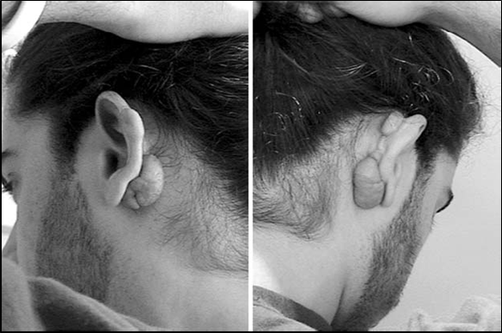
Hypertrophic
Red/pink, raised, puritic, hypersensitive, confined to wound margins, subside with time
Collagen bundles lie relatively flat, with fibres arranged in wavy pattern, but predominantly parallel to epithelial surface
Keloid
Raised, puritic, painful, hypersensitive, spread into normal tissue, rarely regress, continue to worsen over time
fibres lie in haphazardly connected loose sheets, randomly orientated to epithelial surface
Strong genetic disposition

Slide 4
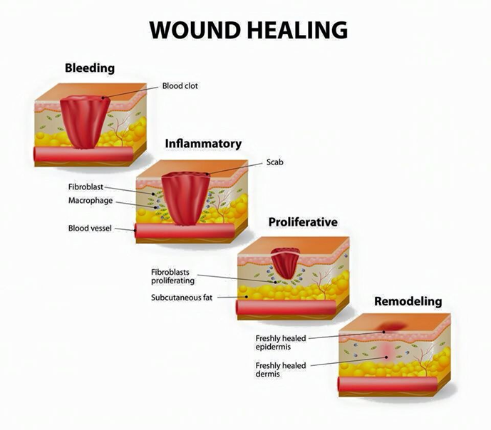
What is a scar ?
A scar is a mark that is left on the skin after a wound or an injury to the surface of the skin has healed”
It is a permeant change in the skin.
Scar formation – Laying down of scar tissue 1-2 years
Scar maturation/Remodeling – up to 5 years

Slide 5
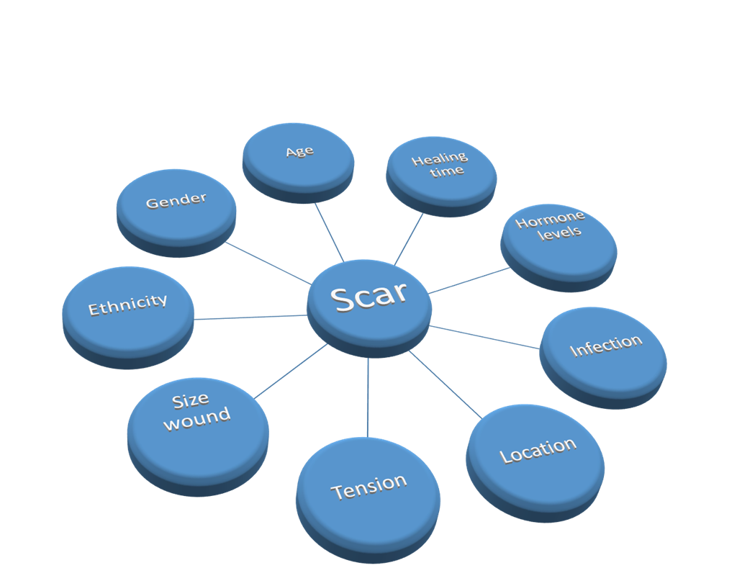
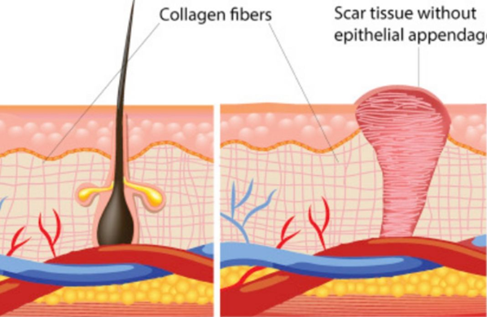
Scar formation – New scar formation
All surgical graft and donor sites will form scars
Laying down of collagen bundles

Slide 6
Scar Specific treatments
Pain and itch
Medication, injectable therapy , LPG
Vascularity/Redness
Pulse Dye Laser, pressure therapy, compression.
Off loading of tension
Pliability of scar
Maintaining skin and joint mobility to keep full ROM
Minimising tension, positioning. Massage LPG, Erbium glass or ablative laser.
Massage, LPG, Pressure therapy, Silicone, Laser therapy, injectables
Thickness/ Hypertrophic
Texture of Scar
Pigmentation of scar
Massage, use of conformers e.g silicone or otoform, Laser therapy
Sun avoidance, topical medication, microneedlng, laser therapy (Pico)

Slide 7
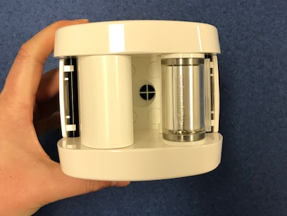
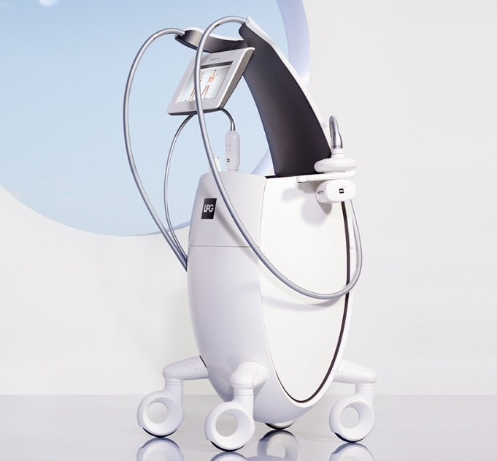
Endermologie / LPG
- Reorganisation of collagen bundles
- Can be used on large or small areas
- Not on highly vascular or inflammatory scars

Slide 8
Pulse Dye Laser | CO2 laser | Erbium Glass laser | Pigment lasers | IPL ( Intense pulsed light)
Reduces redness in new scars. | Reduce thickness and tightness of scars | Promotes remoddling of scar tissue | Reduces pigment in skin | Reduce hair growth
Shuts down small blood vessels in the top layer of the skin. | Puts small holes through the scar up to 4mm deep | Heats up columns of tissue in scars. Treats scars up to 1.5mm | Breaks down excess pigment in skin | Heats hair and damages root
Slows down scar formation Speeds up scar maturation | Remodels scar. | Remodles scar | Reduces and evens out pigmentation | Reduces unwanted hair growth
No Analgesia needed | Painful treatment, needs analgesia | Topical analgesia | Cooling only needed | Cooling only needed
Can be used on any red scar from as early as possible. | Can be used on new or old scars | Can be used on any age of scar | Can be used on any mature scar | Can be used on any age of scar
*Cannot be used on pigmented scars* | Might cause hyperpigmentation | Minimal risks | Difficult to control amount of pigment treated. ( And we don’t have one) | Can only be used on brown hair.

Slide 9
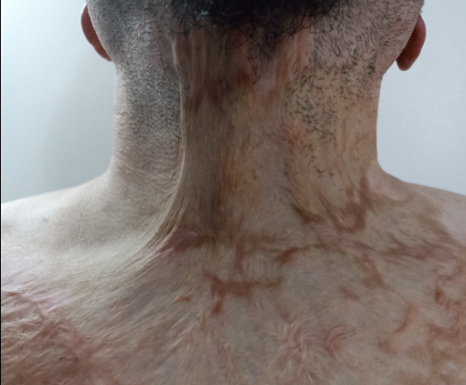
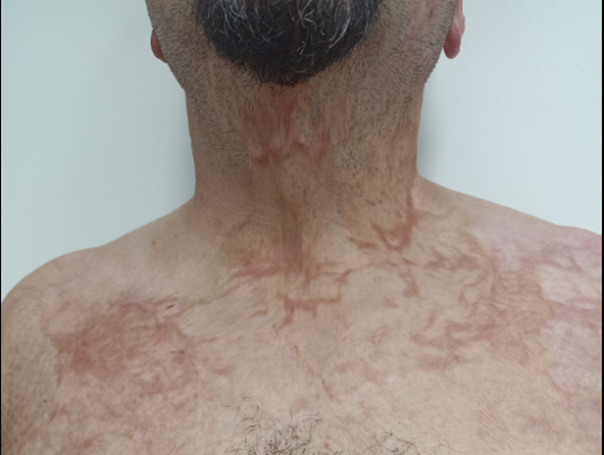

Slide 10
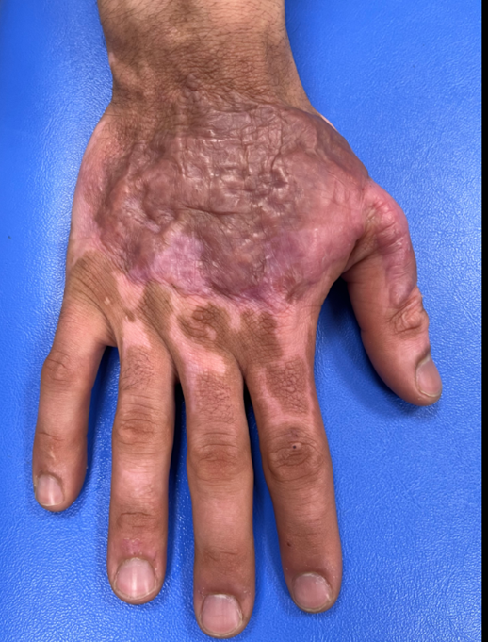
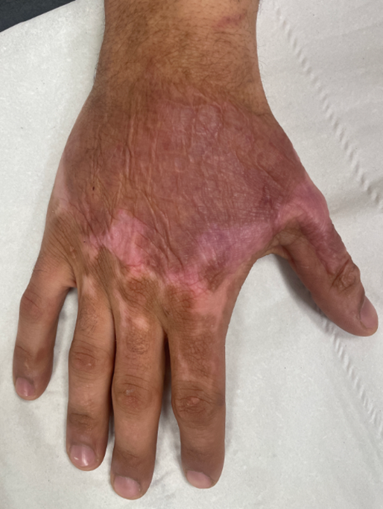

Slide 11
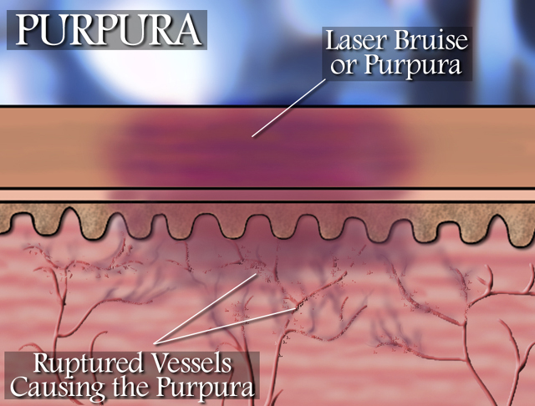
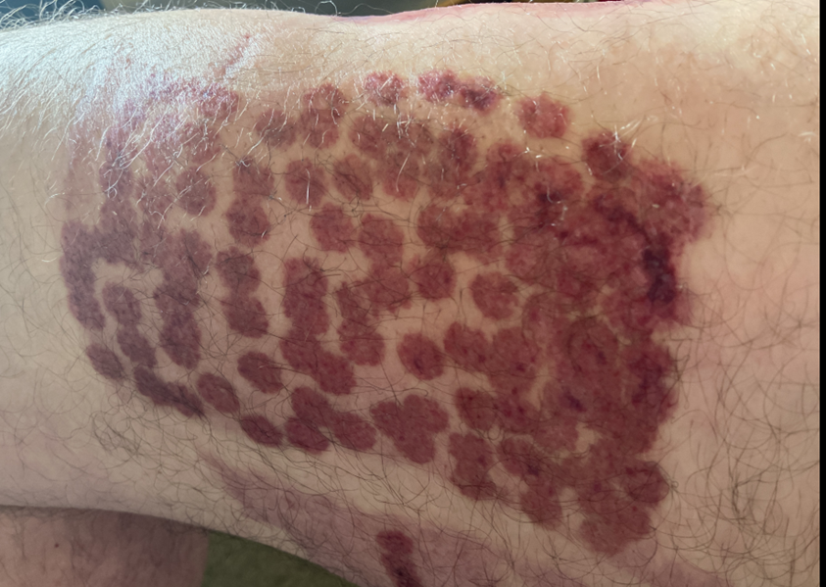
Purpura

